Slide 1
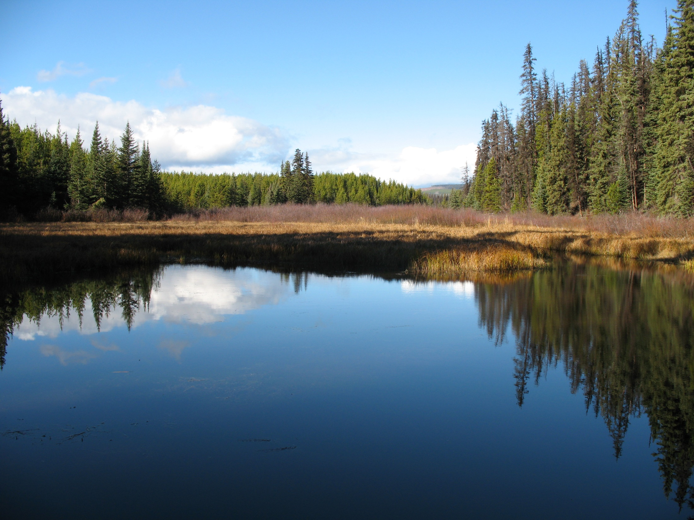


Slide 2
Improving the Prospects for Shallow Water Wetlands
through Upland Vegetation Management
Torsten Kaffanke
May 17, 2016
Notes:
Time is short – 20 minutes

Slide 3
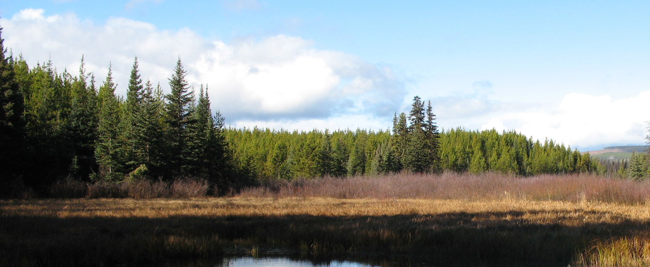
Objectives
1. Identify areas where vegetation in the adjacent upland areas no longer supports beaver colonies.
1a. Where appropriate, develop prescriptions to promote restoration of suitable vegetation (mainly aspen).

Slide 4
Objectives
2. Consider current management practices in riparian areas and whether harvest and silviculture could be used to manage for beavers.

Slide 5
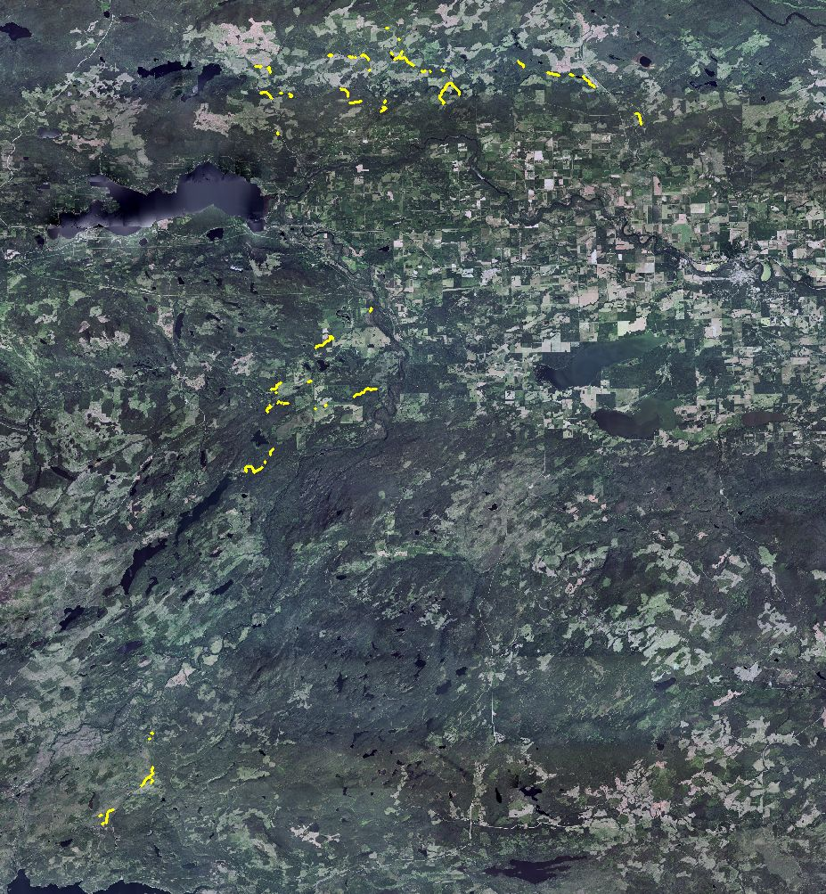
Fraser Lake
Vanderhoof
Kenney Dam

Slide 6
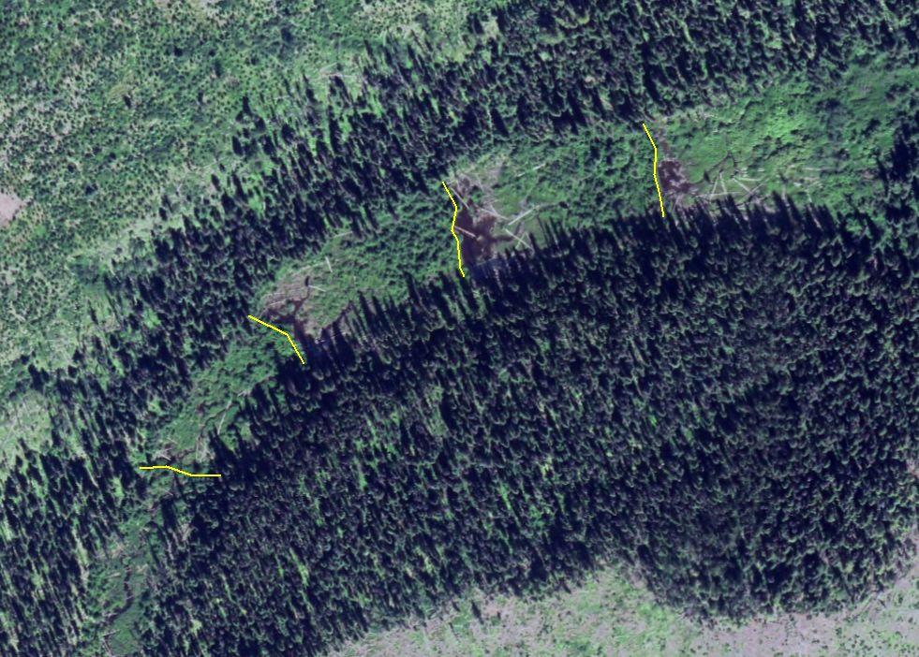

Slide 7
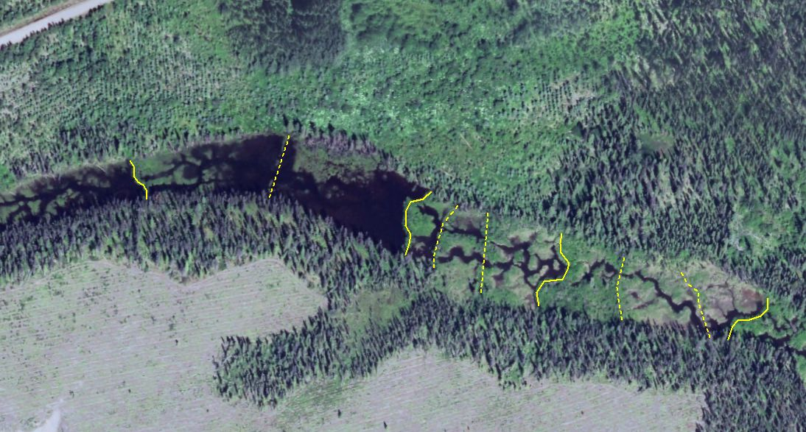

Slide 8
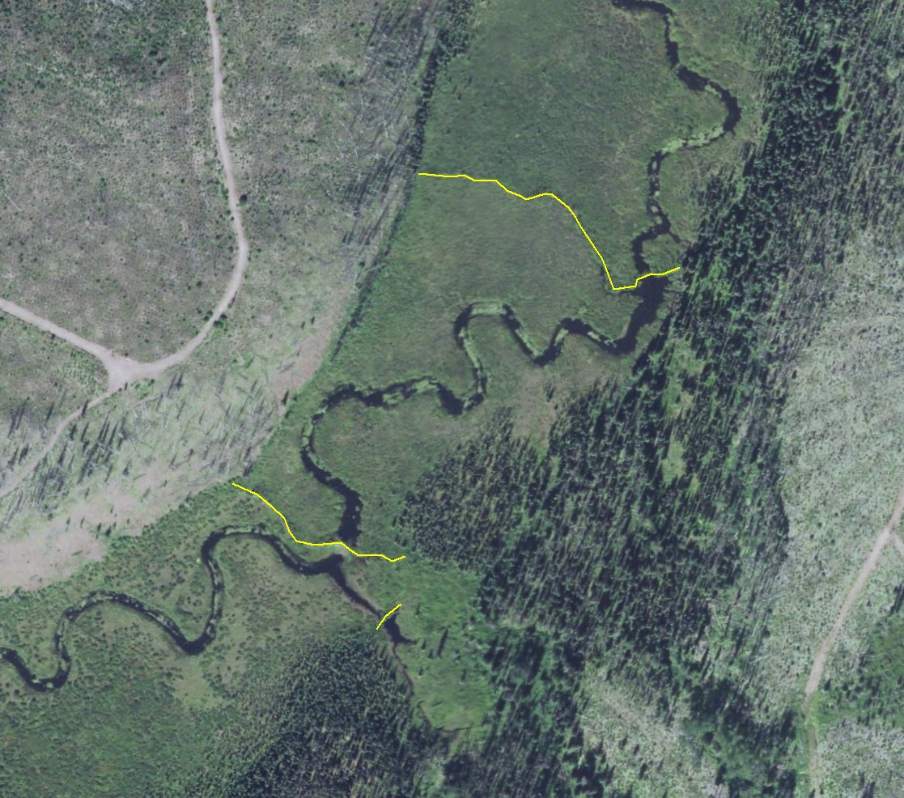

Slide 9
Why are these places important?

Slide 10
Increased Water Retention and Base Flows
Increased residence time
Change timing of release
Losing streams can become gaining streams
More water, including groundwater, in system
Consider this in light of climate change-induced drought
Notes:
Dams lengthen residence time, change timing of release.
Losing streams can be changed to gaining streams with dams.
Lateral spreading and increased areas of saturation mean more water, including groundwater, in a watershed.
Think about this benefit with respect to climate change induced drought.

Slide 11
Decreased Peak Flows
Reduced erosive energy
Less sedimentation downstream
Notes:
Water is retained in ponds and subsurface for later release.
Reduction in peak flows reduces erosive energy, thereby reducing sediment deposition downstream.
The complicated flow path through multiple small channels that typically exist below beaver dams also dissipates the erosive energy.

Slide 12
Expansion of Habitat Area and Complexity
Moving water environment -> combination of moving and slow water
More riparian and wetland habitat
Habitat heterogeneity due to irregular timing of colonization, abandonment, recolonization.
System is more resilient to disturbance, especially flooding and drought.
Notes:
Moving-water environments are converted to combination of moving- and slow-water habitats with a greater amount of riparian and wetland habitats.
Colonization, abandonment, and recolonization at irregular intervals leads to heterogeneity in habitats along the stream with a rich mosaic of wetland types of widely ranging ages and stages of succession.
The resulting complex system is more resilient to disturbance, particularly from the extremes of flooding and drought.

Slide 13
Increased Wetland Area
Ponds force water flow laterally.
Multiple channels increase habitat complexity.
Notes:
By raising the surface water level, beaver ponds force water flow laterally. Water spreads over banks, and also around the dams into new channels, creating a complex network of channels and wetlands.

Slide 14
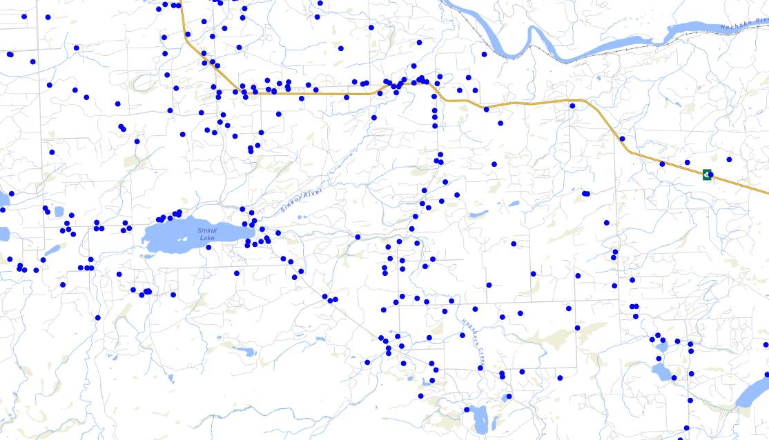
Increased Groundwater Recharge
Overbank flooding is main mechanism for recharging groundwater in riparian areas.
Notes:
Overbank flooding is generally thought to be the main hydrologic mechanism for recharging groundwater in riparian areas. Beaver dam impoundments flood these areas for long periods of time, resulting in sustained recharge.
Hydraulic head due to dam height forces water into the streambed and banks, and can promote lateral flows of groundwater around the dam and eventually back into the channel further downstream, and at a later time (thereby increasing residence time and base flow).
Both groundwater storage and aquifer recharge are increased due to beaver dams, and this is increasingly important where climate change is reducing water availability or where groundwater is used faster than it is replenished.
Groundwater is not subject to the evapotranspiration losses of surface water.

Slide 15
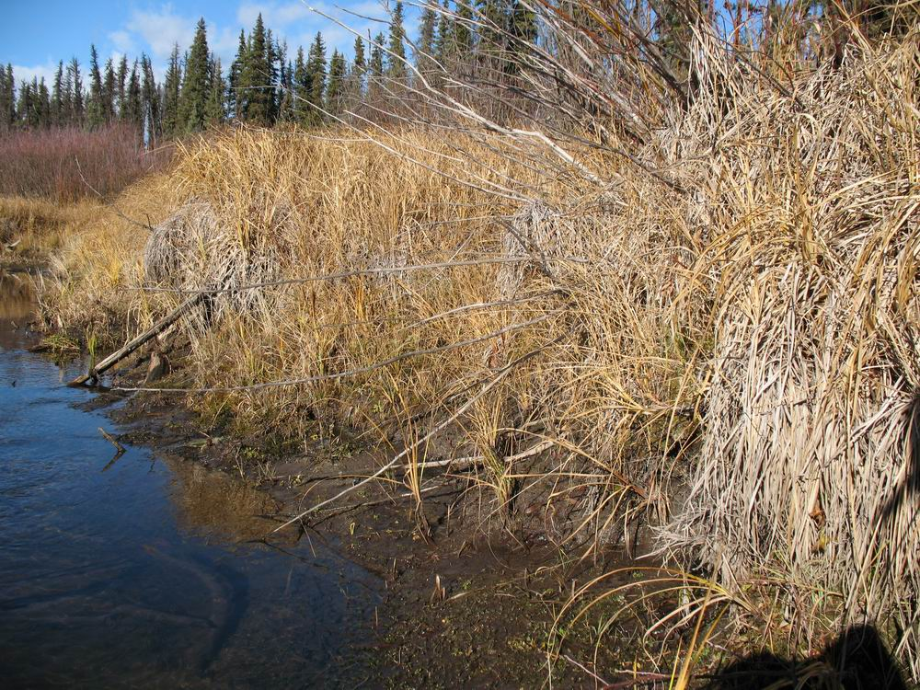
Sediment Retention
Notes:
By increasing water depth, slowing velocity, and decreasing flow energy, beaver dams promote sediment deposition. The amount of sediment deposited in beaver ponds is strongly related to the surface area of the pond.
Beaver dams can affect the transport rate of both suspended and bedload sediments and act as long term sinks. Even when the dams on small streams are breached after abandonment, most of the sediment can remain in the pond area (beaver meadow), with channel avulsion occurring in the immediate area of the breach.
The amount of sediment capture can be impressive, and has been expressed in various ways in different studies: 63% of suspended sediment by 10 dams during peak flow; 78 tons in a single snowmelt period behind four dams; 5847 cubic yards stored behind 22 dams in a 620 m length of stream.

Slide 16
Temperature Moderation
Timing of release
Ponds are temperature stratified
Hyporheic exchange -> temperatures sometimes lower downstream of dams
Notes:
Maximum summer temperature is often the limiting factor for fish habitat, so riparian vegetation management practices are often aimed at protecting streamside vegetation to promote shading and thereby minimize summer stream temperature increases. Although the surface waters of beaver impoundments receive more solar radiation than flowing stream reaches, and therefore may warm considerably, deeps ponds usually remain stratified, with cool water at depth. Cooler water below dams has been reported, and the mechanism for this includes hyporheic (subsurface volume of sediment and porous space adjacent to a stream through which stream water readily exchanges) upwelling from the earlier-discussed groundwater recharge.
Large ponds tend to dampen temperature fluctuations.

Slide 17
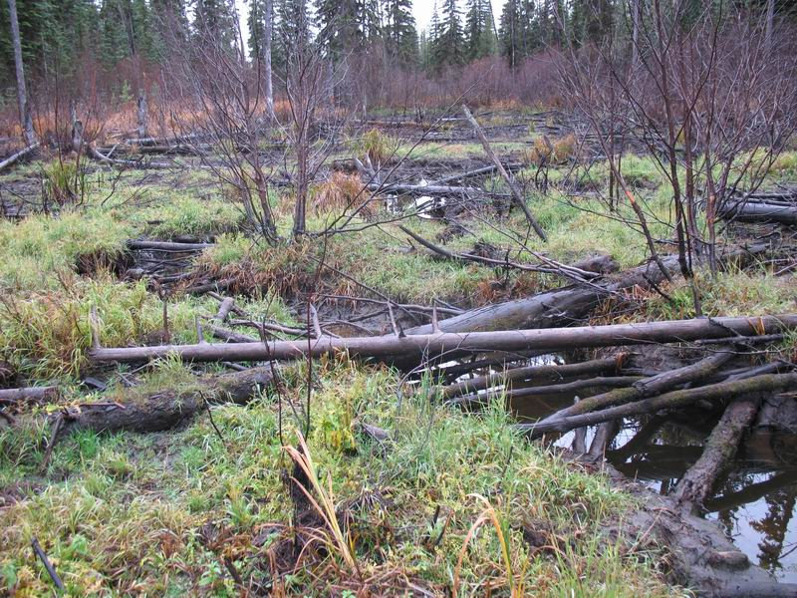
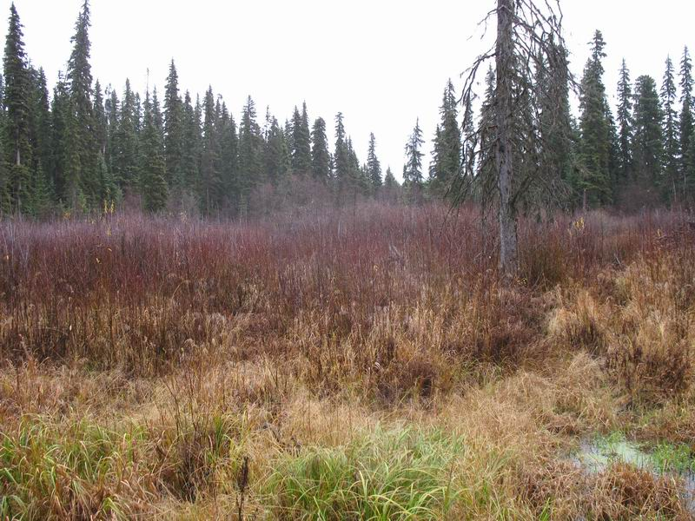
Nutrient Cycling
Ponds trap organic and inorganic debris
Aerobic conditions after draw-down releases nutrients
Notes:
The feeding habits of beavers and their physical alteration of the environment affect biogeochemical cycling and the accumulation of nutrients in soils, sediment and water.
Beaver ponds trap large amounts of organic and inorganic debris that would normally be transported downstream.
When dams are abandoned and water levels subsequently decline, exposing these sediments, the return of aerobic conditions releases nutrients in a form available to vegetation, allowing dense and rapidly growing communities.

Slide 18
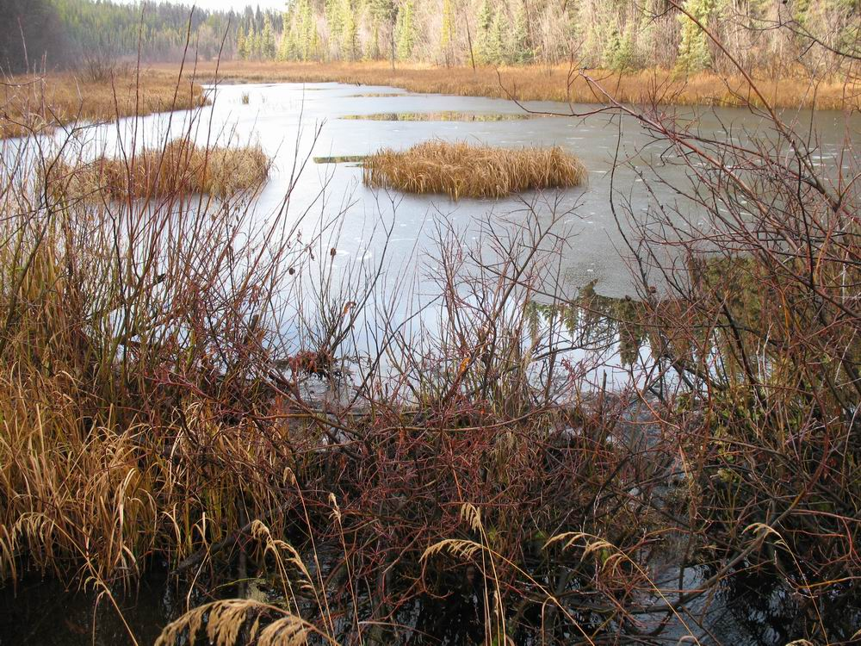
Contaminants
Residence time is important.
Deposition, microbial decomposition, plant uptake, chemical transformation, adsorption to clay particles.
Notes:
By increasing the residence time of water in a system, and through a variety of mechanisms including deposition, microbial decomposition, uptake by plants, chemical transformation augmented by filtering, and adsorption to trapped clay particles, beaver ponds and wetlands act as sinks for nutrients and toxins that would otherwise stimulate the growth of algae, other plants, and bacteria further downstream.

Slide 19
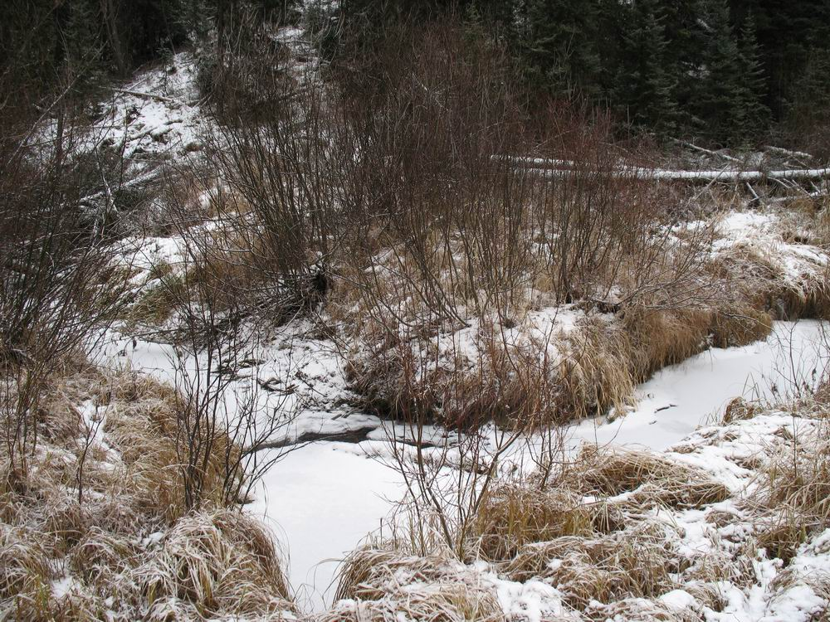
Geomorphology
Channel incision -> disconnection of streams from floodplain
Notes:
Channel incision is a widespread phenomenon throughout the world that causes ecosystem degradation through disconnection of the stream from its floodplain, lower groundwater tables, loss of wetlands, decreased summer low flows, higher stream temperatures, less overall habitat diversity, loss of riparian areas, and population declines in fish and other aquatic organisms. Beaver dams can reduce the rate of channel incision and even reverse it in degraded streams.
Sediments trapped behind beaver dams cause streambed aggradation in the affected reaches; the same sediments are therefore unavailable to downstream locations where they may be less desirable.

Slide 20
Vegetation
Shrubs and trees -> riparian and emergent
Reduced flow velocity, increases sediment trapping even more than dam
After abandonment, succession of communities
Notes:
The obvious effect of beaver dams is that riparian and emergent vegetation develop to dominate where there used to be upland shrubs and trees. This vegetation further reduces flow velocities and increases rates of sedimentation beyond what the dam itself causes.
After abandonment and dam breaching, the newly exposed sediments in the beaver meadow offer rich growing conditions, and the site progresses through successional stages from young and wet to old and moist plant communities.
Due to varying dates of meadow creation following breaching, and their subsequent recolonization by beavers, the system of dams on a stream creates a complex of wetland communities whose composition and structure varies, contributing to landscape level heterogeneity.

Slide 21
Primary Productivity and Aquatic Invertebrates
More sunlight to more surface water
-> increased photosynthesis in the aquatic system
-> larger base of the food web that supports fish.
Notes:
Creation of a beaver pond starts a chain of effects, beginning with an increase in organic nutrients and by allowing more sunlight to reach more surface water to power photosynthesis by various primary producers.
Secondary producers - varied micro- and macro invertebrates - flourish with the increase in primary production. These form the base of the food web that fish rely on when rearing or overwintering in beaver ponds.

Slide 22
Fish
Common view that beaver ponds somehow interfere with fish habitat, especially the notion that dams act as barriers to passage.
Positive effects of dams are more often supported by data, and negative impacts are more often speculative, and not supported by field data.
Fish found in stream reaches that have beaver dams are both larger and more numerous than fish found in streams lacking slow water habitat.
Notes:
There are commonly held views that beaver ponds somehow interfere with fish habitat, especially the notion that dams act as barriers to passage. One review of the literature showed that positive effects of dams were more often supported by data, and that negative impacts are more often speculative, and not supported by field data.
Beaver ponds slow the flow of water, reducing the energy expended by foraging fish. They also increase the amount of aquatic invertebrates and provide high edge to area ratios that increase cover for fish. The result is that fish found in stream reaches that have beaver dams are both larger and more numerous than fish found in streams lacking slow water habitat.
Overwintering habitat has been identified as the production bottleneck for Coho salmon in at least one stream system, and that increasing beaver populations would effectively mitigate this loss of productivity. Other salmonid species have also been identified as benefitting from beaver dams.

Slide 23
Amphibians
Reptiles
Important breeding habitat, e.g. blue-listed Western Toad
Reduce egg and hatchling larvae susceptibility to desiccation
Painted turtles, snakes
Old ponds attract more reptiles than young ponds.
Notes:
Beaver ponds provide important breeding habitat for some amphibians, for example, the blue-listed Western Toad. Beaver dams increase the amount of surface water and retention times within their catchments, and this may reduce egg and hatchling larvae’s susceptibility to desiccation.
Painted turtles use beaver ponds. As climate change continues to warm the central interior of BC, the range of these animals may move northward, and beaver ponds will continue to be a feature of their habitat.
Snakes are commonly found near beaver ponds. Both the common garter snake and the wandering garter snake occur in central BC.
Older ponds tend to attract more reptiles than younger ponds do, pointing to the importance of having a range of seral conditions in the landscape.

Slide 24
Birds
Waterfowl and other species
Protein and calcium rich food supplies important to hens and their broods
Ponds offer habitat to a hugely disproportionate number of wildlife species compared to the area of landscape they occupy.
Notes:
Beaver impoundments create habitat for waterfowl and many other bird species.
Breeding hens and their broods rely on the protein and calcium rich food supplies provided by the numerous species of aquatic insects found in beaver ponds, as well as the cover provided by riparian and emergent vegetation.
Drowned trees attract woodpeckers and provide nesting habitat for many bird species.
Beaver ponds offer habitat to a hugely disproportionate number of wildlife species compared to the area of landscape they occupy.

Slide 25
Habitat Requirements of
Dam-building Beaver

Slide 26
Habitat Requirements of
Dam-building Beaver
-Interested in those that live in small and medium streams.

Slide 27
Habitat Requirements of
Dam-building Beaver
-Gradient less than 6%, typically 1-2%

Slide 28
Habitat Requirements of
Dam-building Beaver
-Unconfined valley bottom

Slide 29
Habitat Requirements of
Dam-building Beaver
-They will build dams almost anywhere that additional water can be retained!

Slide 30
Habitat Requirements of
Dam-building Beaver
-Riparian areas that contain vegetation for food and construction material for dams and lodges

Slide 31
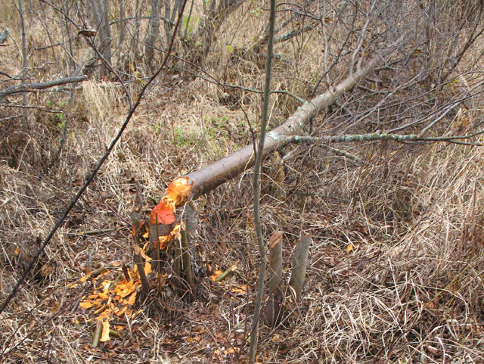
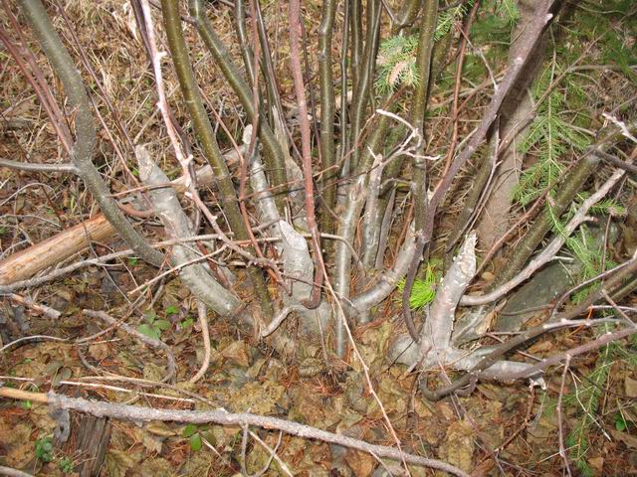

Slide 32
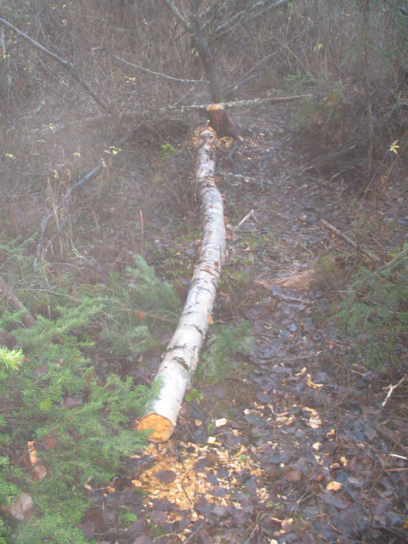
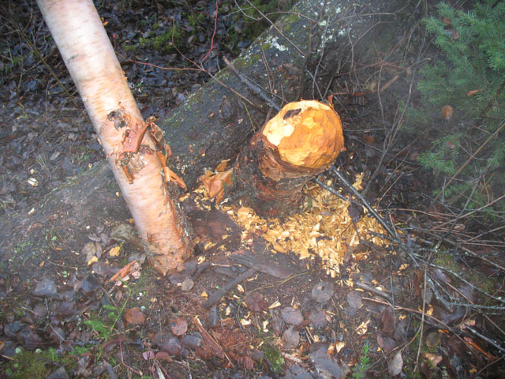

Slide 33
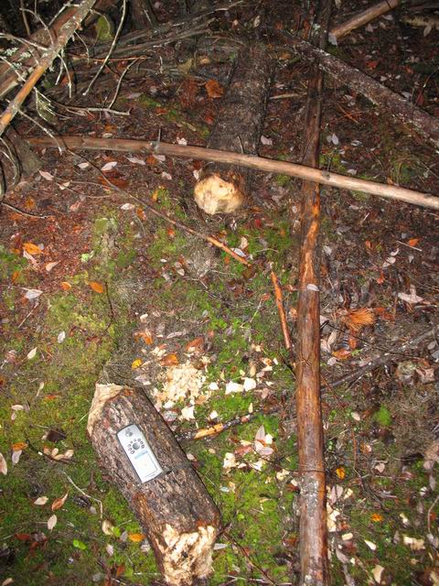

Slide 34
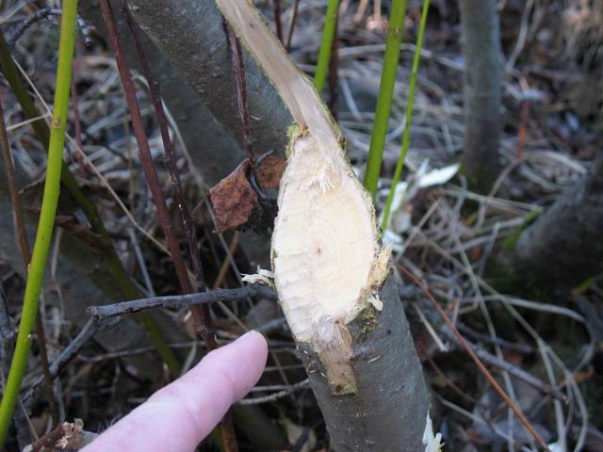
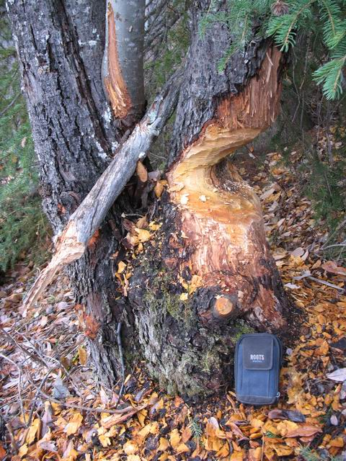

Slide 35
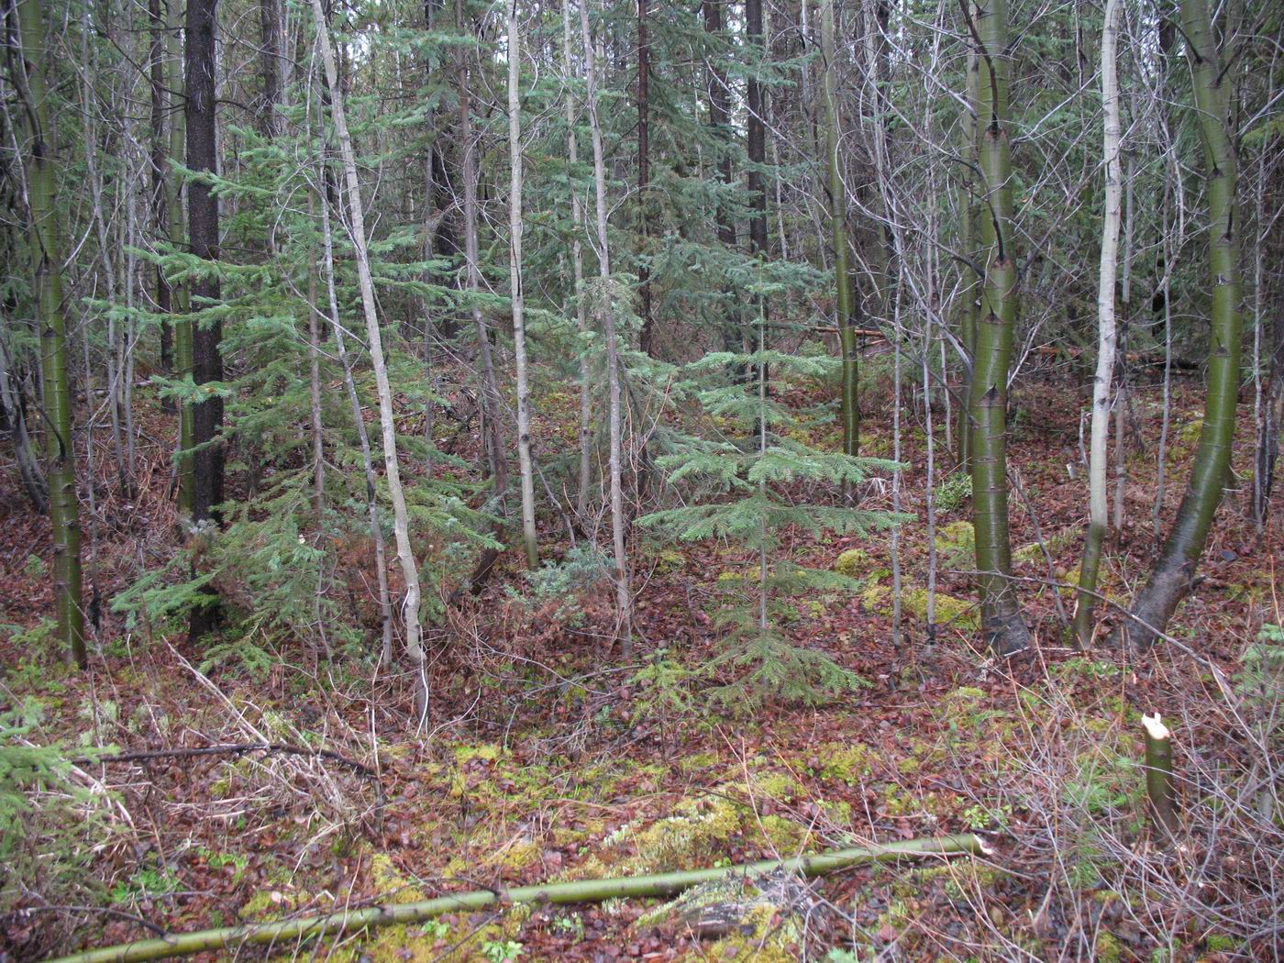

Slide 36
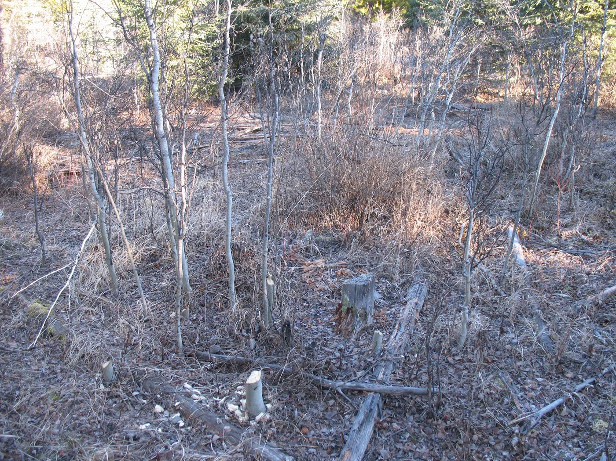

Slide 37
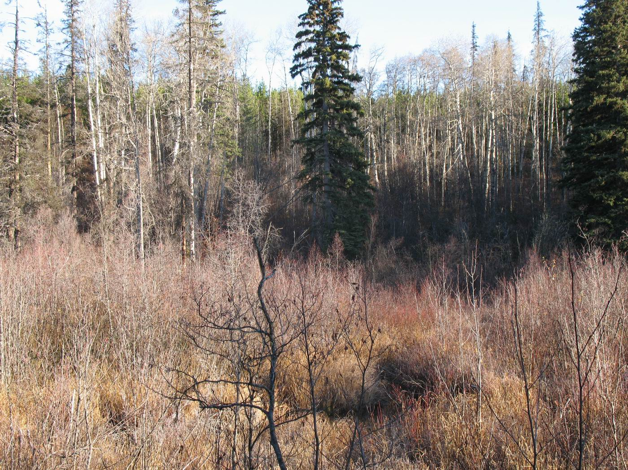

Slide 38
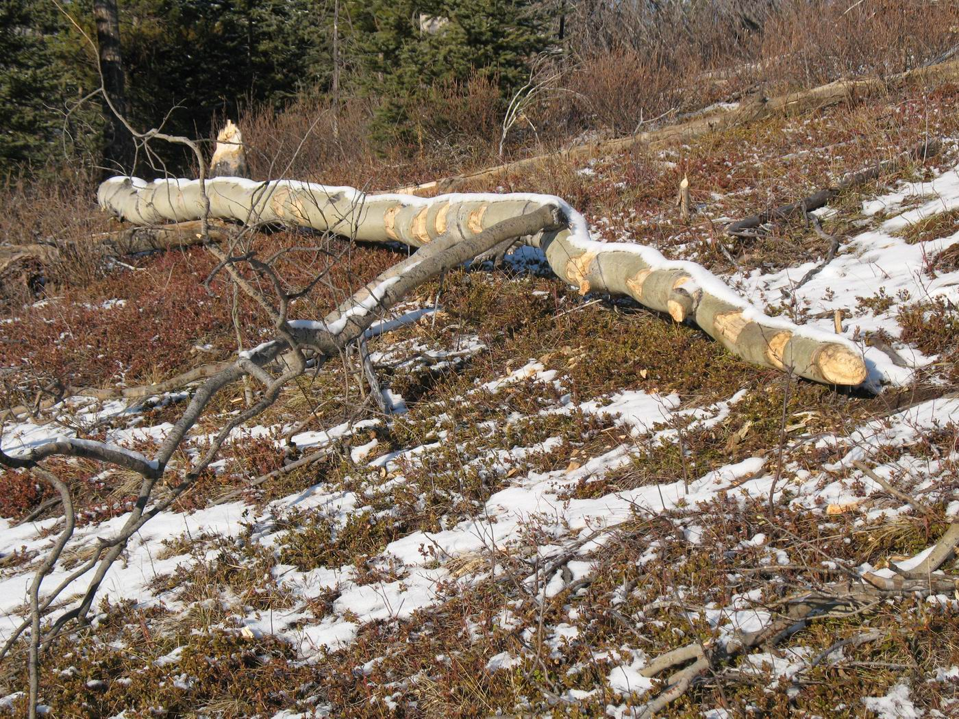

Slide 39
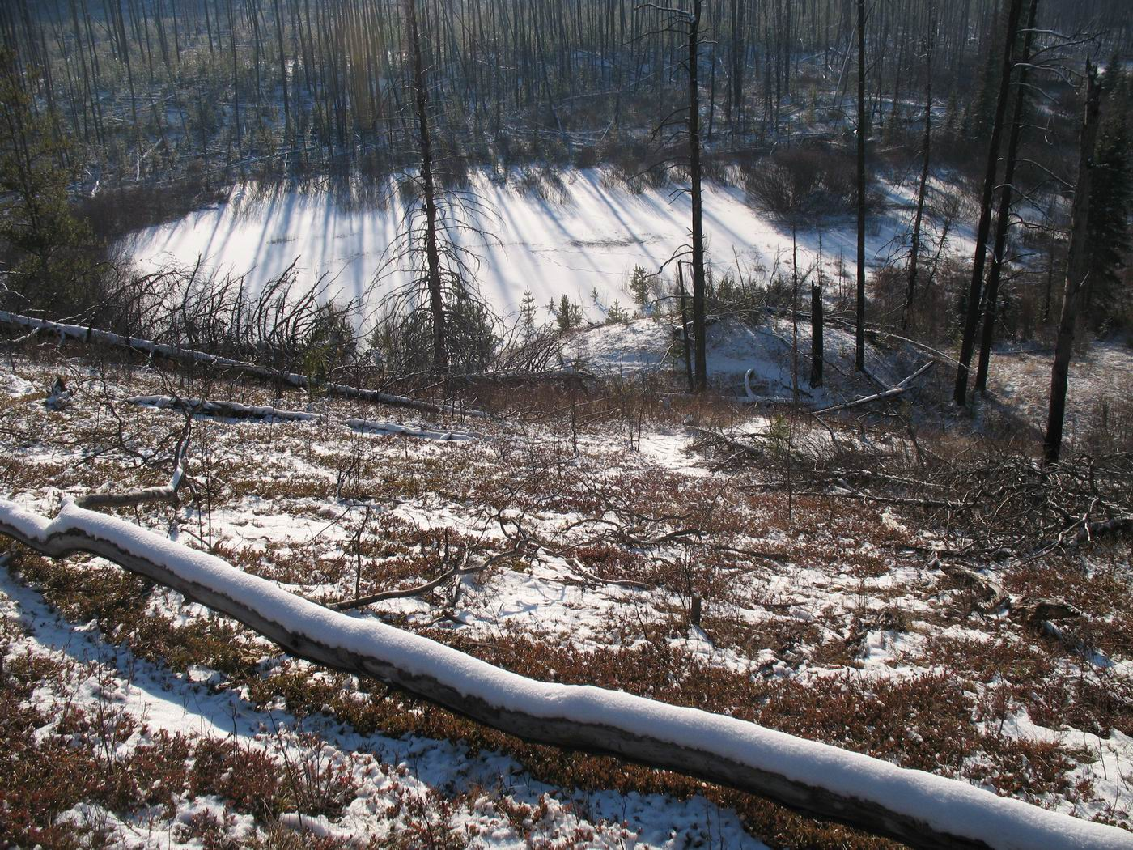
Notes:
Beavers used aspen growing on any site from hygric to subxeric, as long as stems and branches could be dragged to the water.

Slide 40
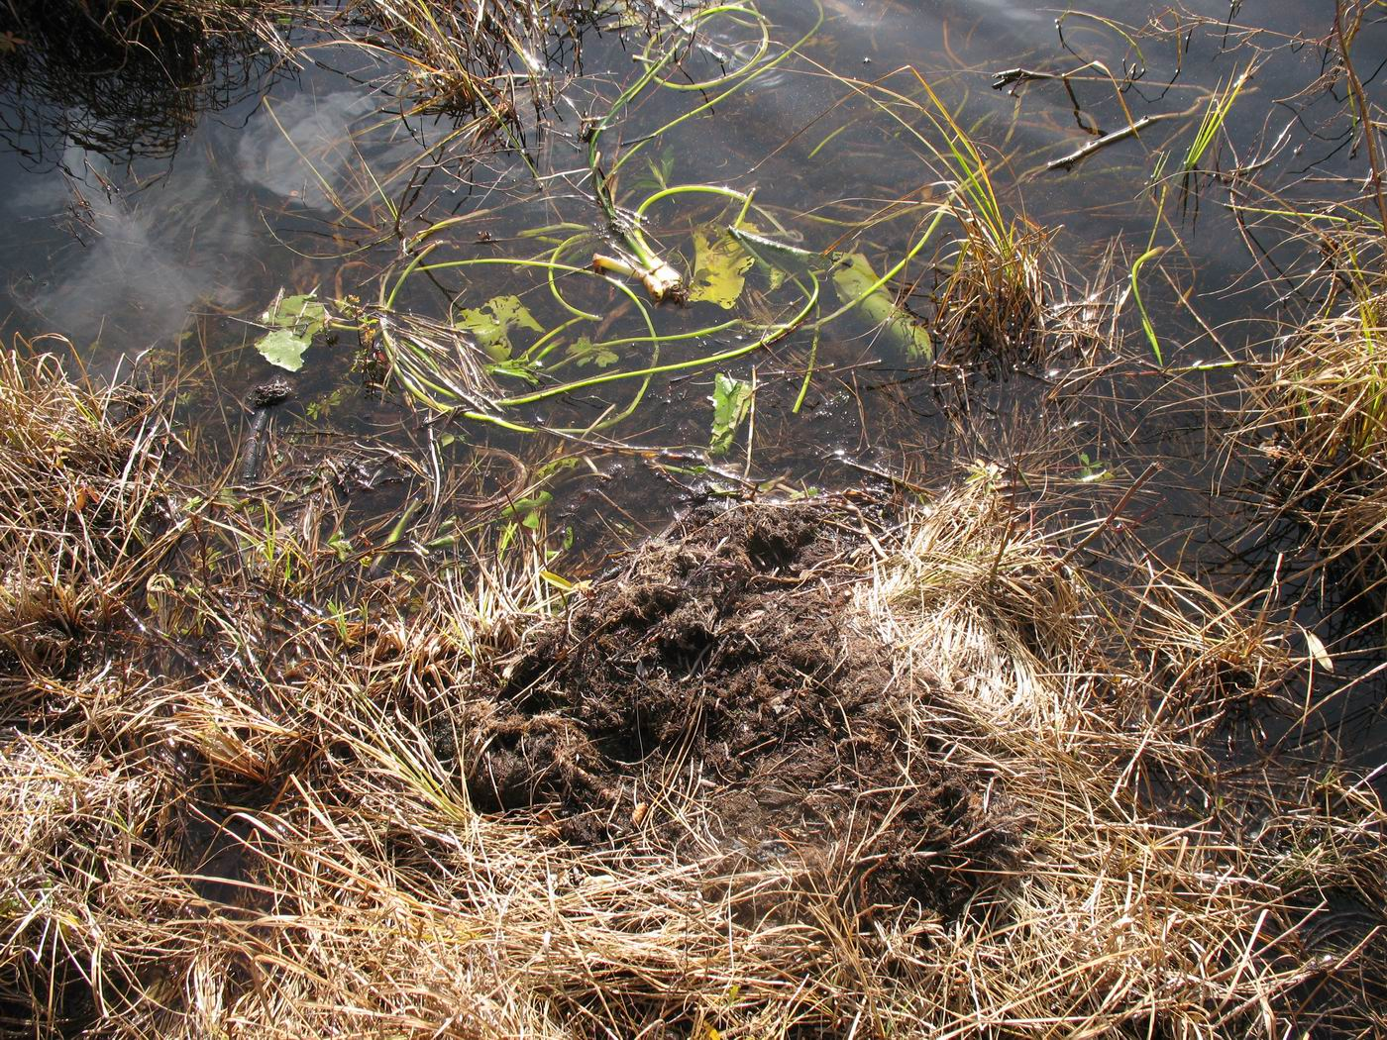

Slide 41
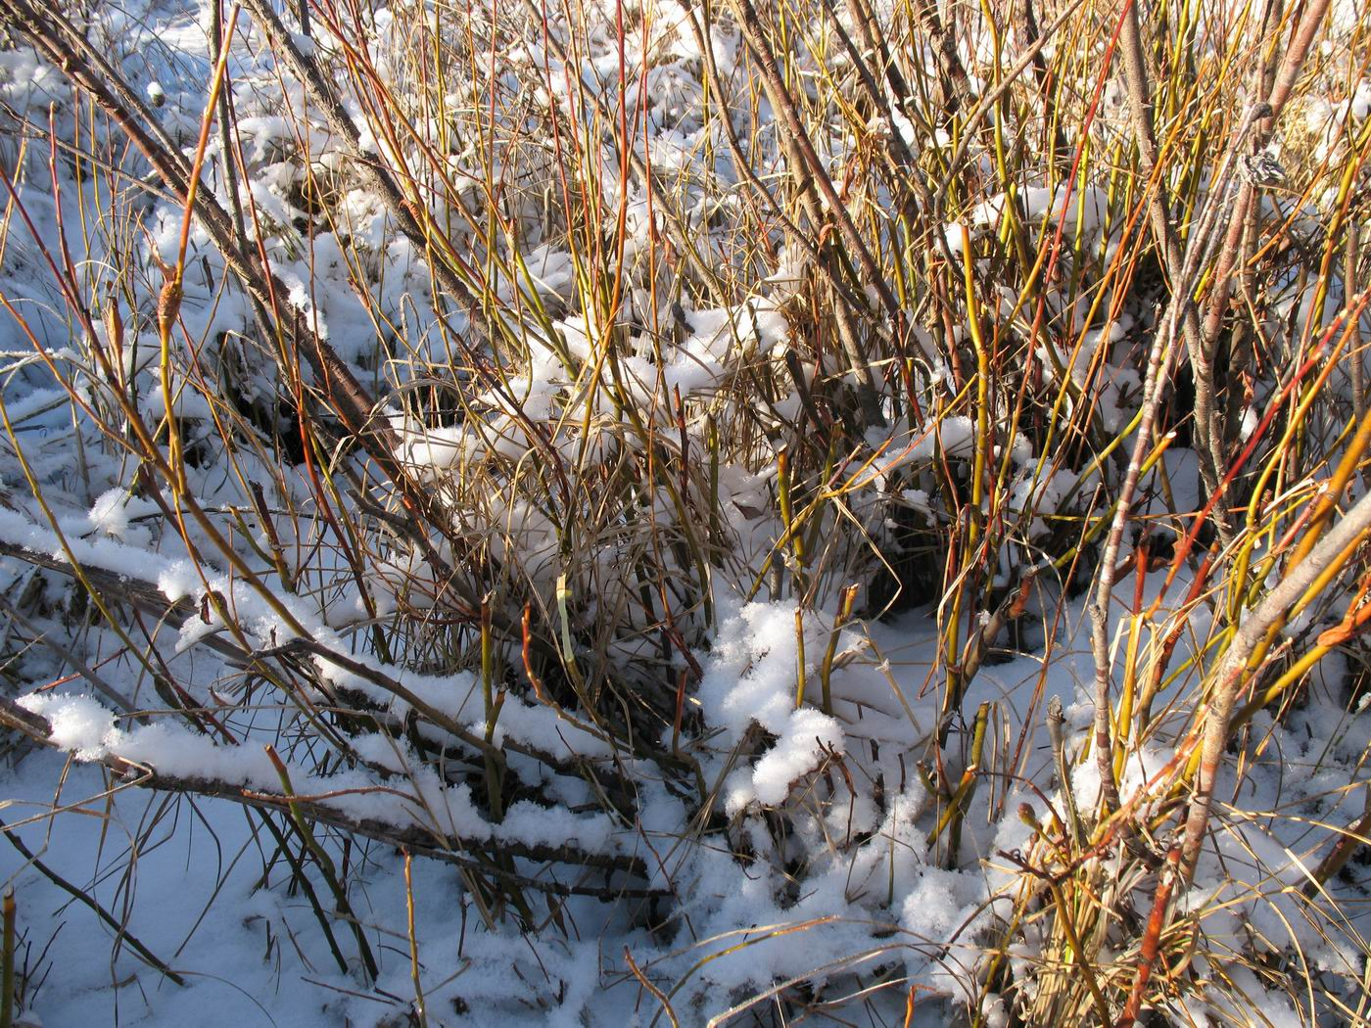

Slide 42
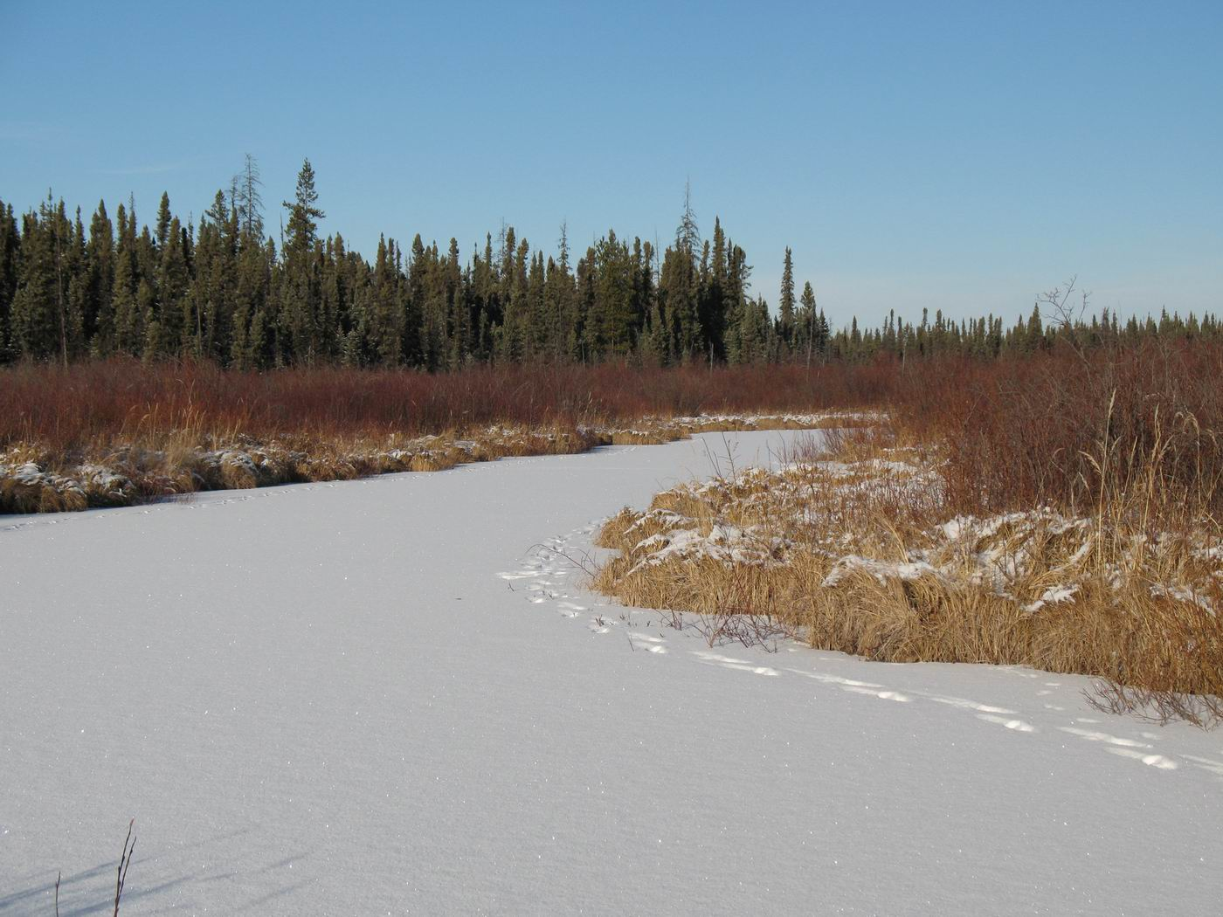

Slide 43
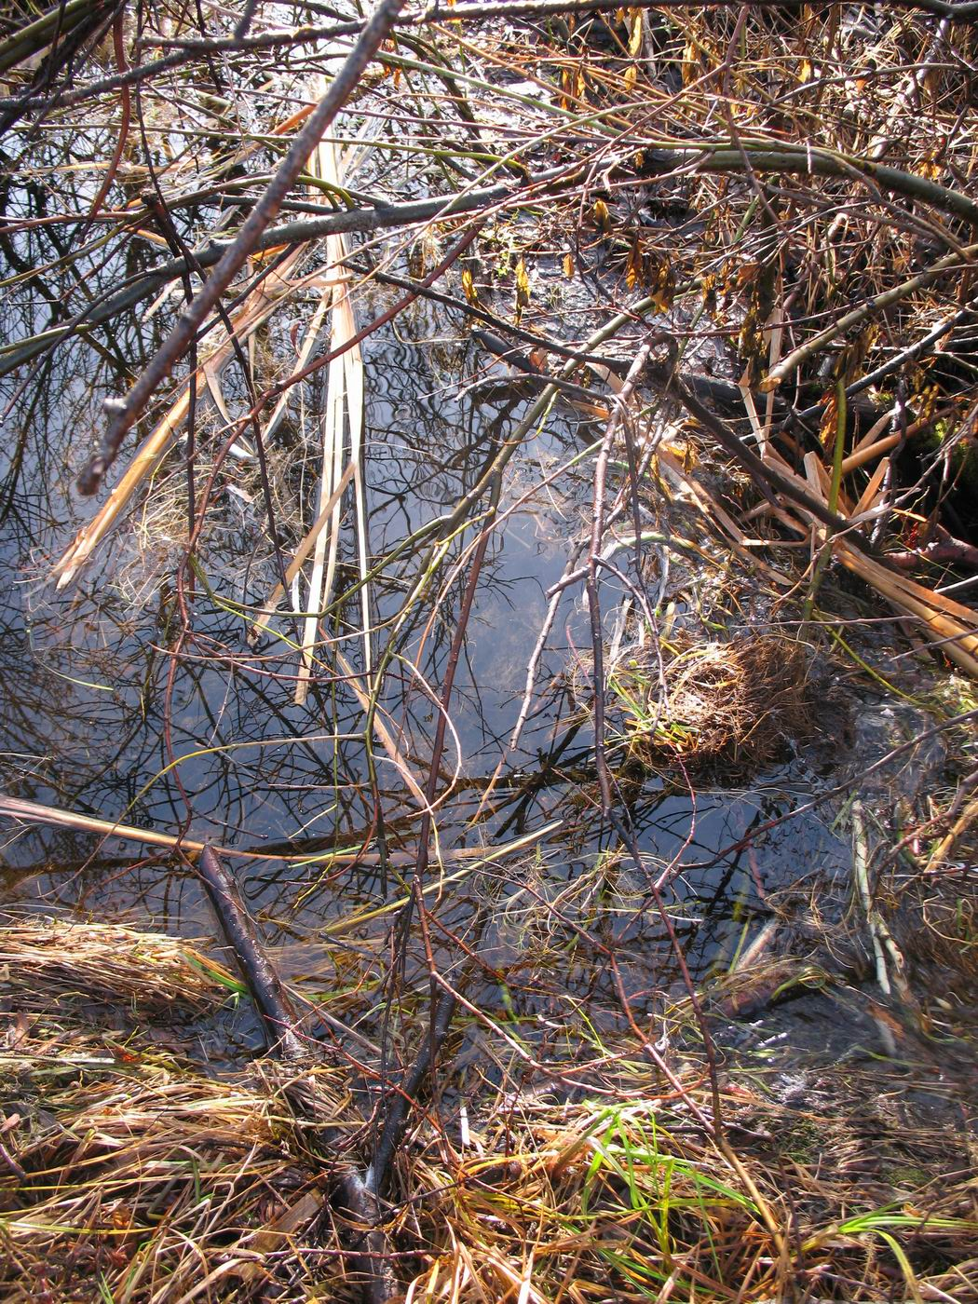

Slide 44
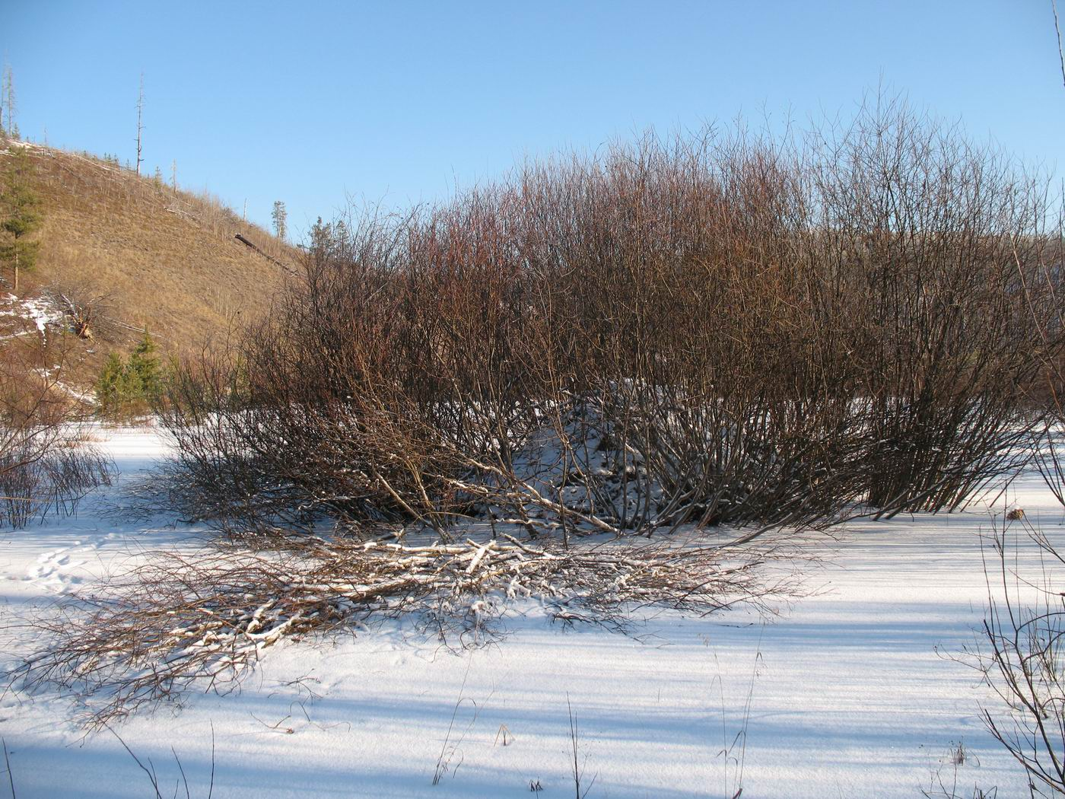

Slide 45
Some local observations of tree use by beaver…

Slide 46
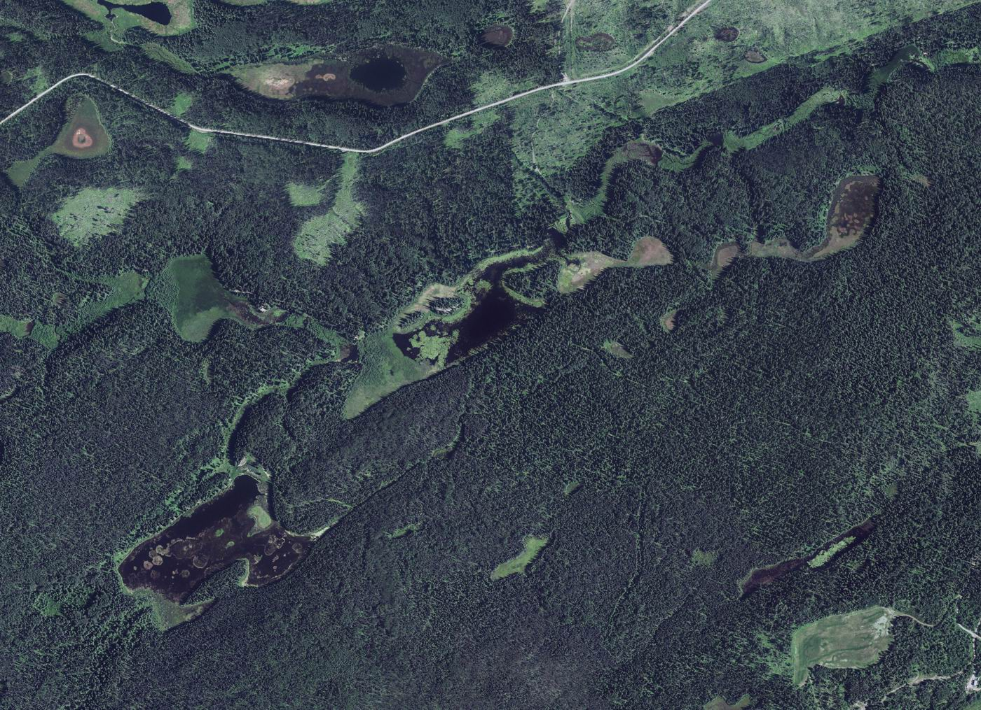
A seeming necessity for aspen within 100 m of the pond margin …
Notes:
but less if terrain makes exploitation of it too difficult. Abandoned dams were almost always associated with a complete lack of aspen in this zone, but old stumps could be found within the remaining conifer forest or open area. Even when willow are plentiful and large, if no aspen is present the site is less likely to support an active colony than if aspen is present.
- Image is Fifteen Creek and Dorman Creek, tributary to Smith Creek.

Slide 47
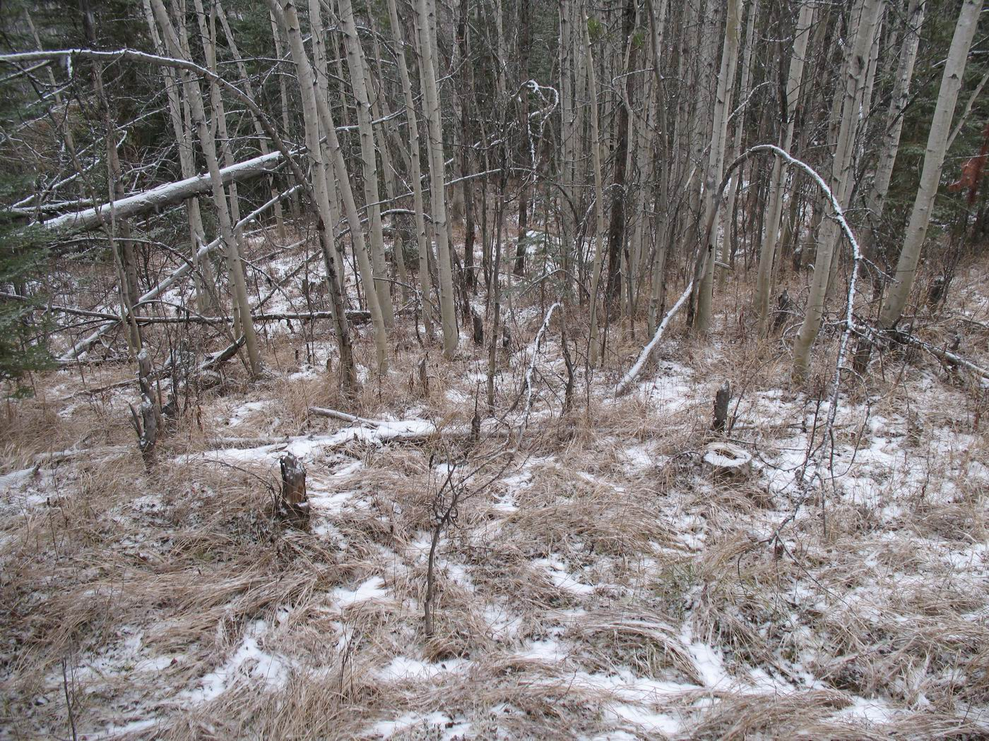
…terrain permitting.
Notes:
but less if terrain makes exploitation of it too difficult. Abandoned dams were almost always associated with a complete lack of aspen in this zone, but old stumps could be found within the remaining conifer forest or open area. Even when willow are plentiful and large, if no aspen is present the site is less likely to support an active colony than if aspen is present.
- Image is Fifteen Creek and Dorman Creek, tributary to Smith Creek.

Slide 48
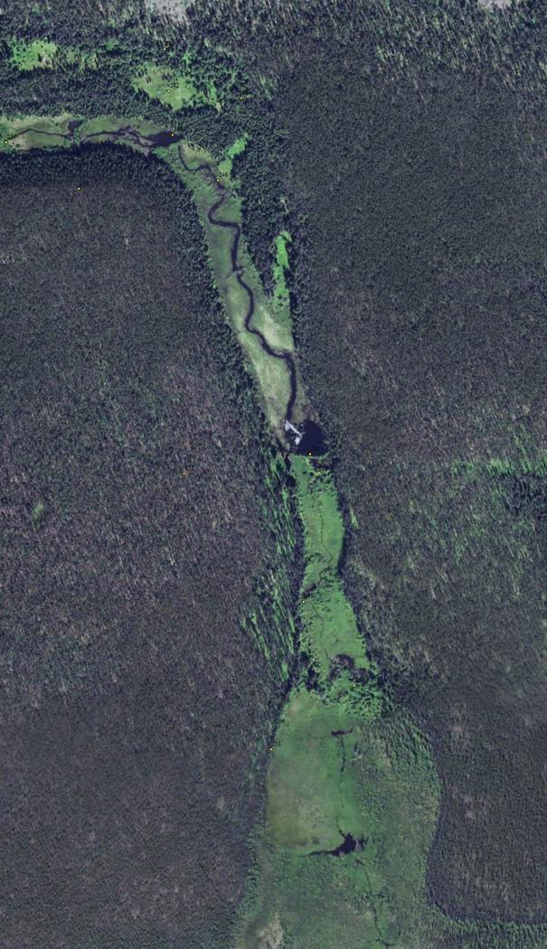
Long conveyance…
70 m to water
then
700 m by water
Notes:
A couple of aspen and cottonwood, 70 m from water, then 700 m to lodge. Cattail in lower reaches.

Slide 49
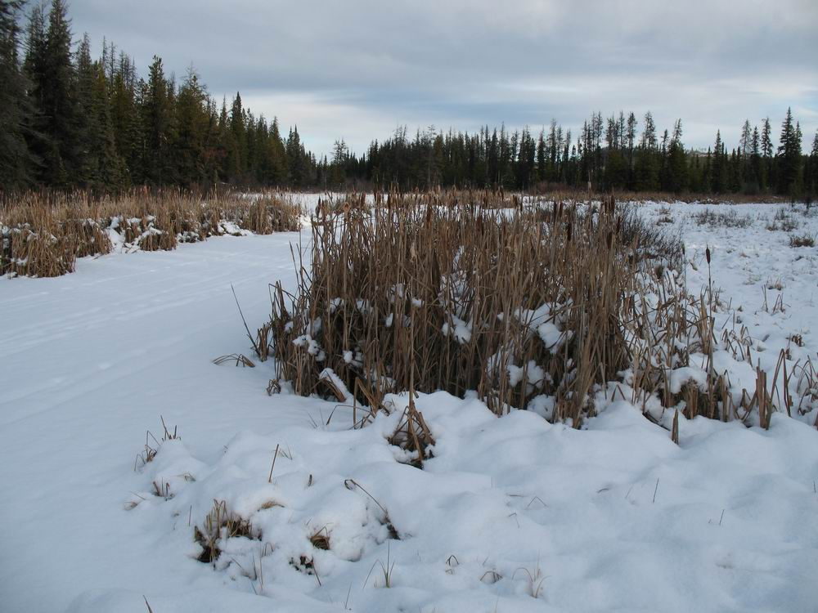
In the absence of aspen…
cattail.

Slide 50
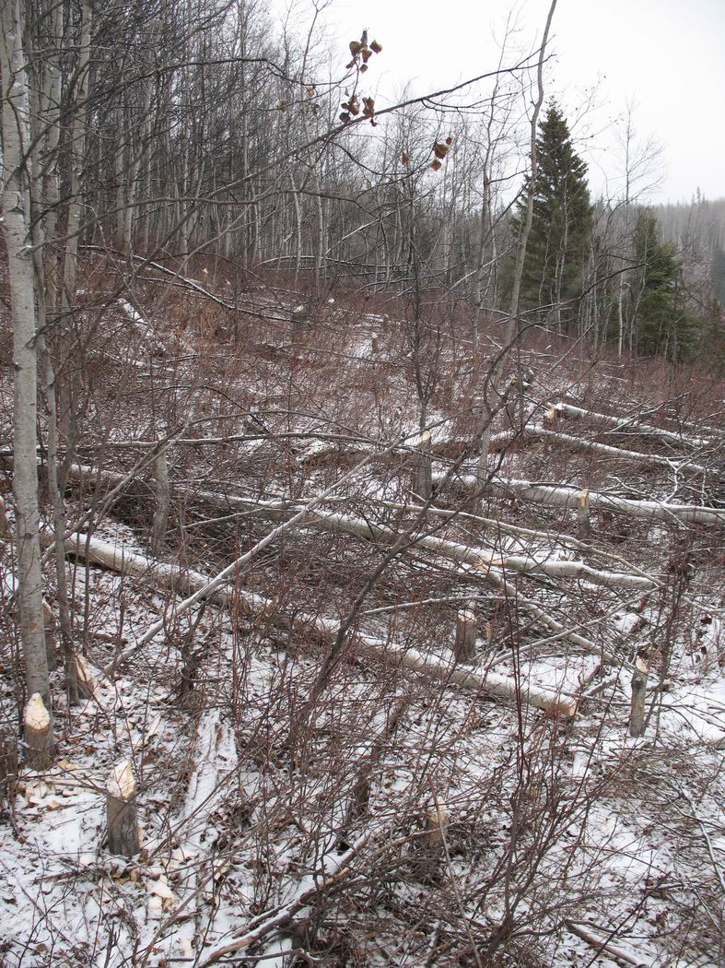
Cutting aspen from the same cohort that an earlier colony used, but deeper into the upland than the earlier colony was willing to use (or “got around to using”).

Slide 51
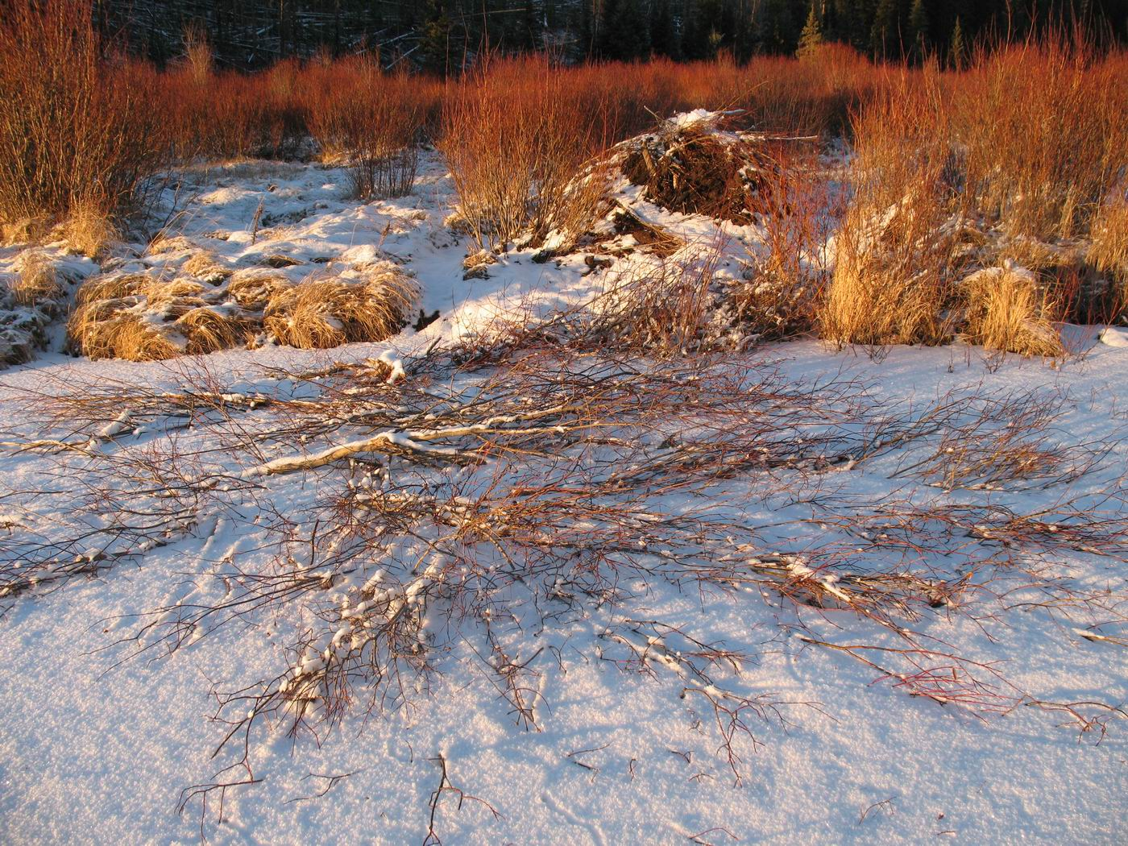
Willow commonly placed over aspen in cache

Slide 52
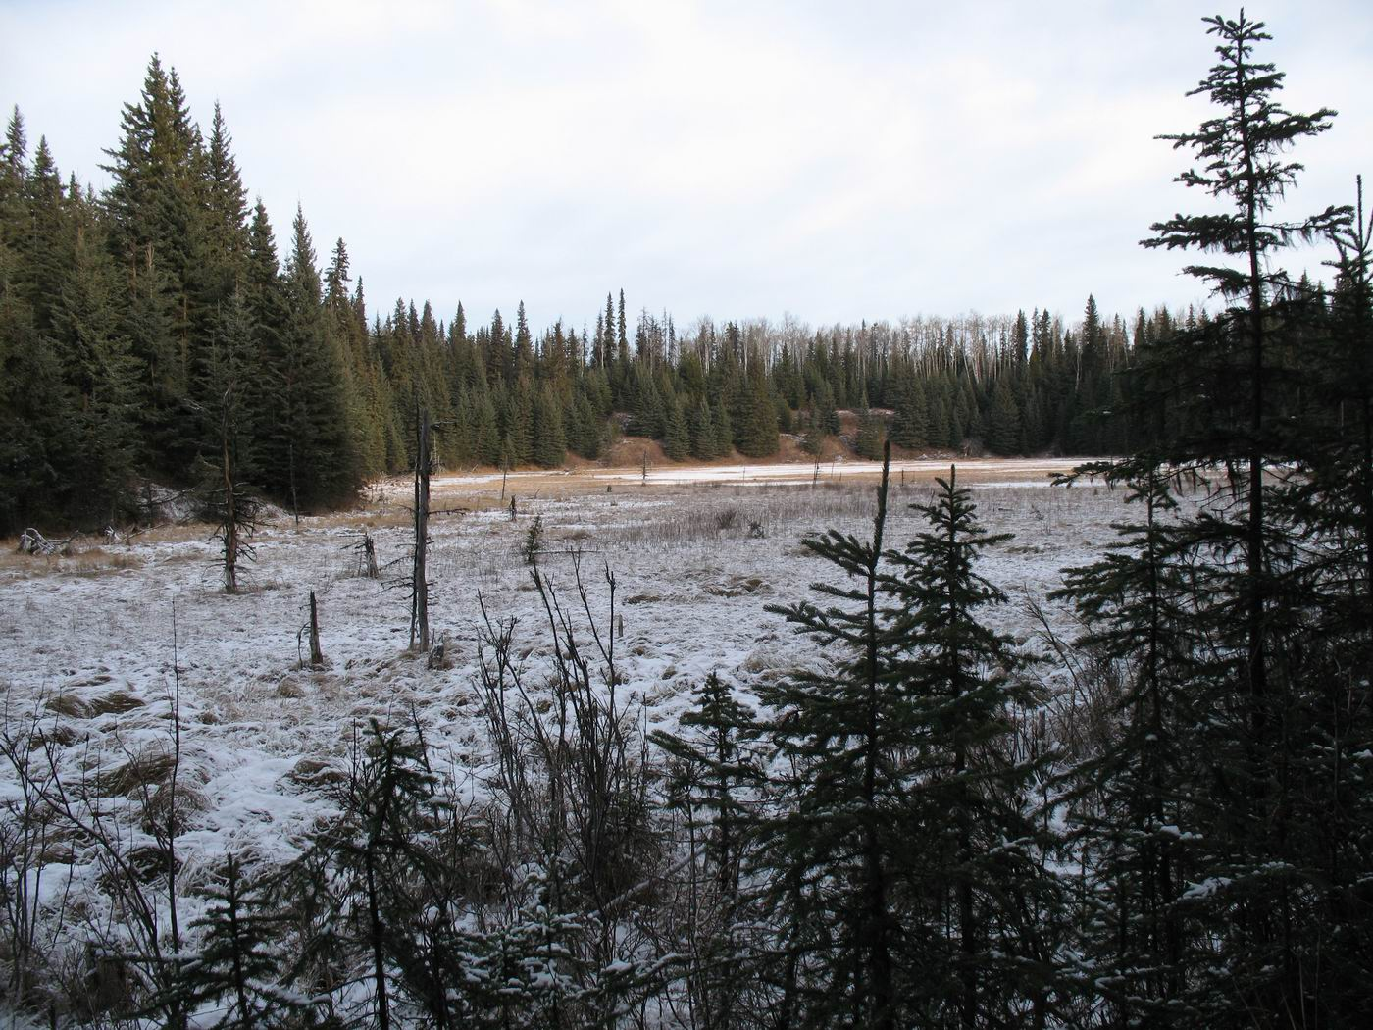
Depleted of aspen, replaced by conifer, often a distinct line.
Notes:
Where the stand is open, aspen suckers have often been browsed concurrently with shrub species.

Slide 53
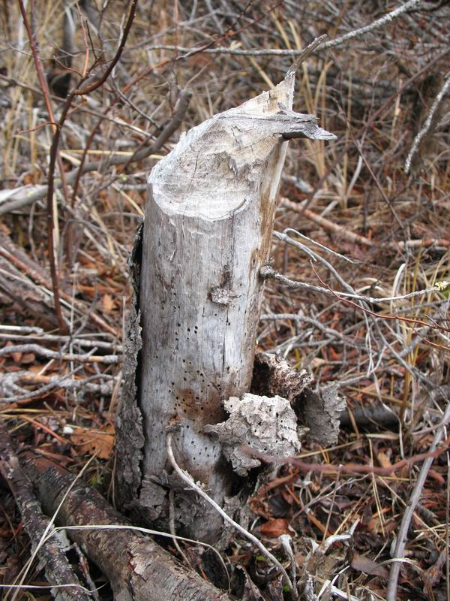
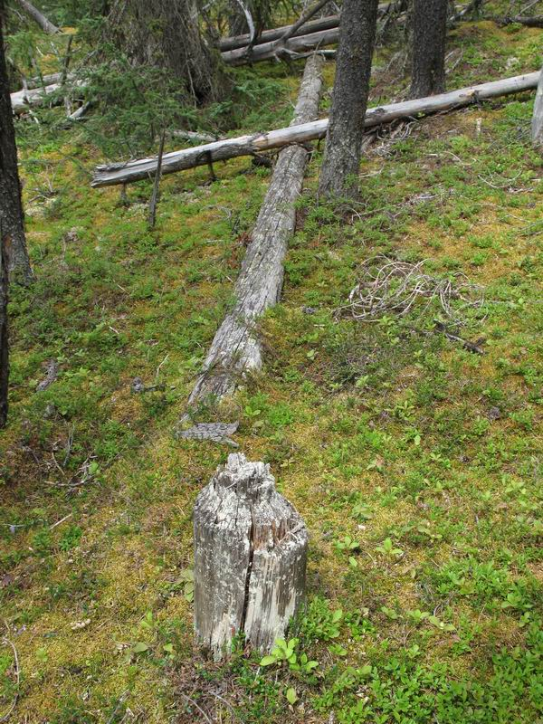
Desperation?

Slide 54
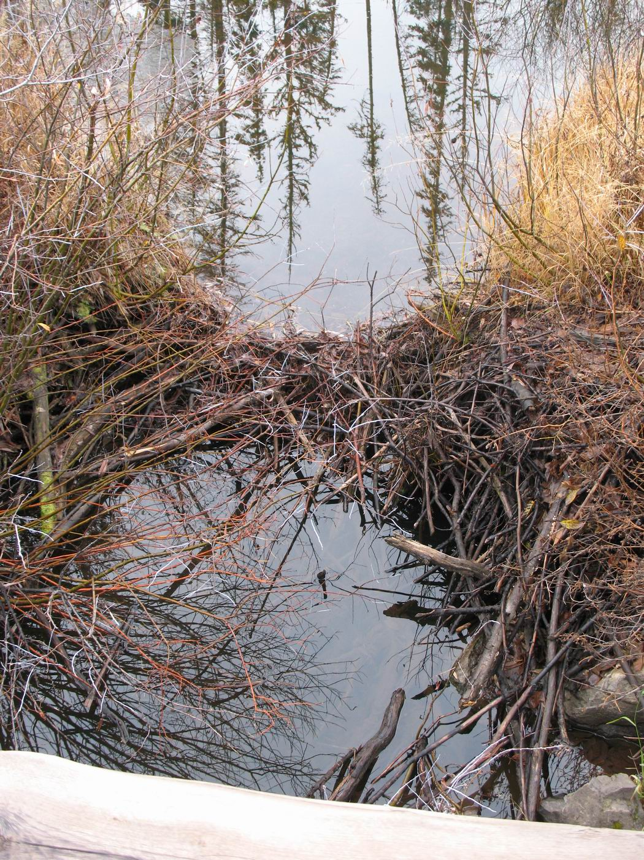
Explore and set up for future use

Slide 55
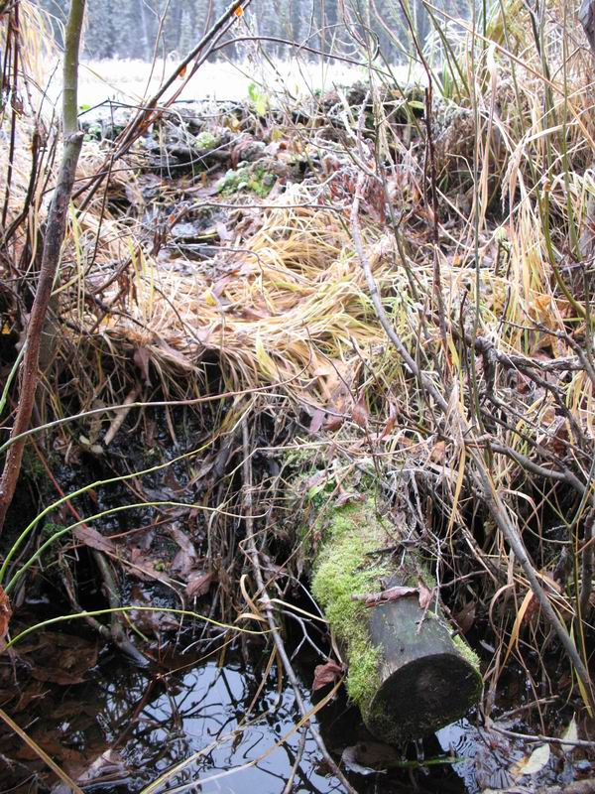
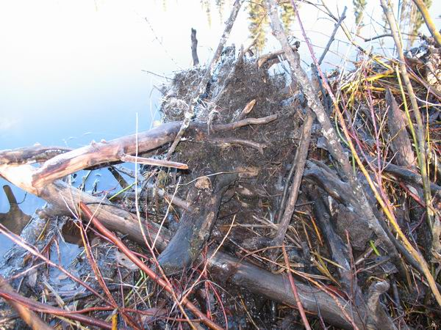
Will use whatever is available, including large cobbles.

Slide 56
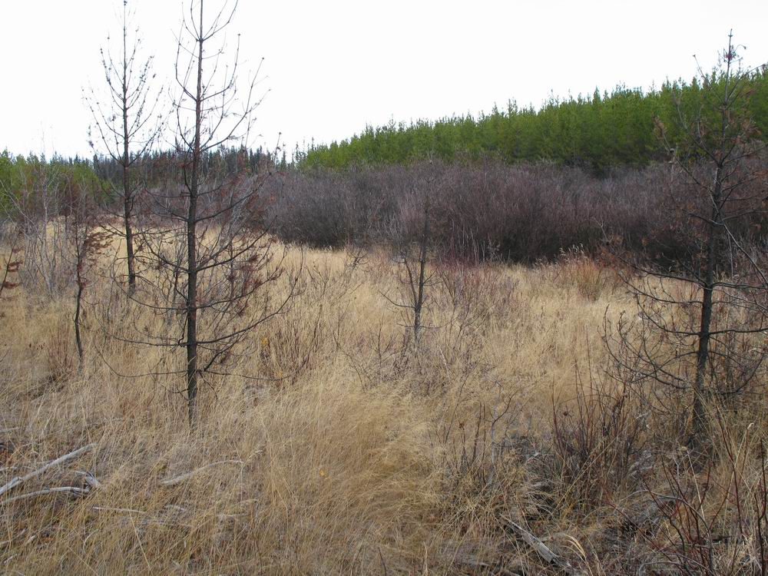
Nuisance flooding? Extent of flooding from recolonization is predictable from vegetation and old dam heights.

Slide 57
Quantifying the Systematic Depletion of Aspen near Beaver Ponds

Slide 58
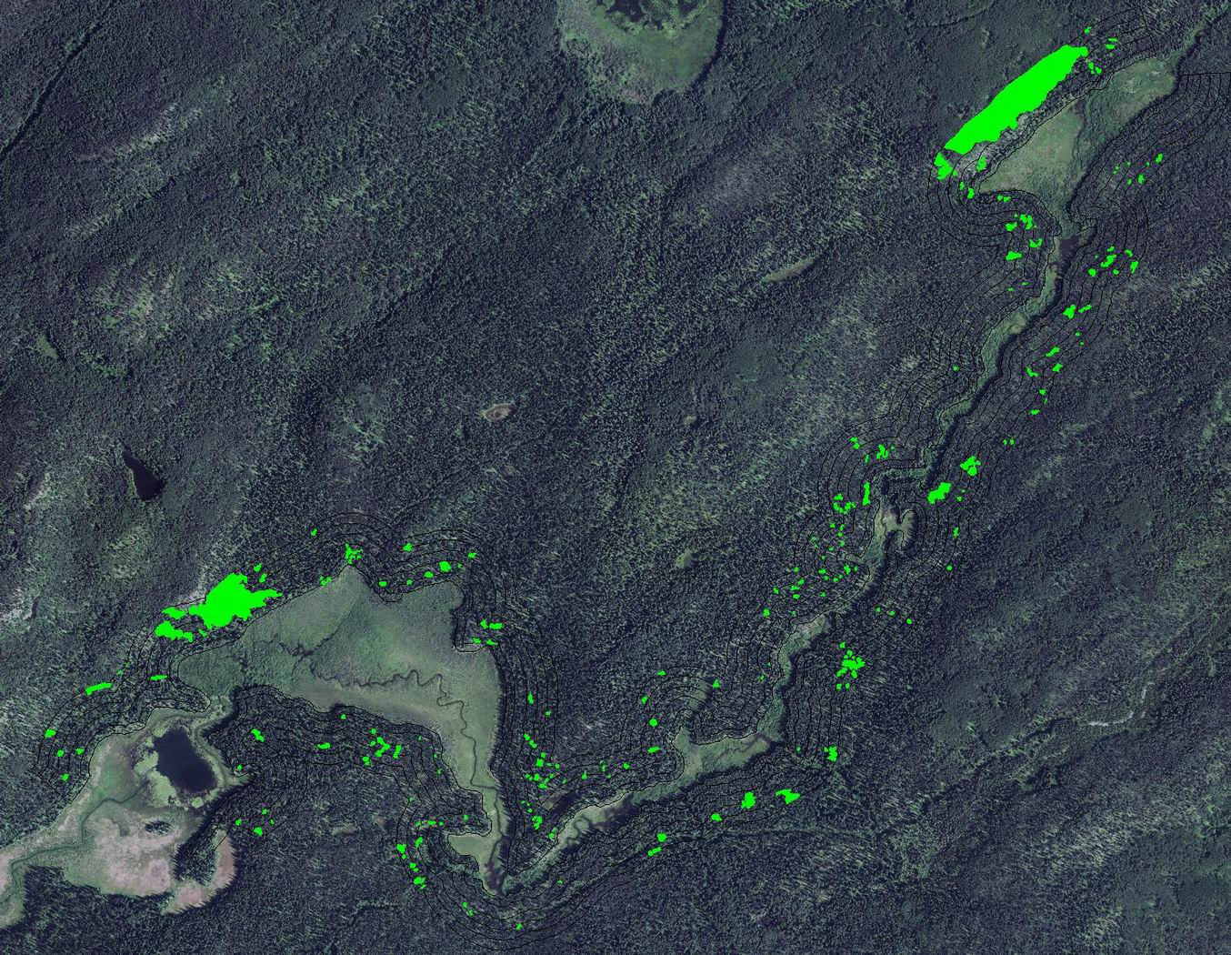

Slide 59
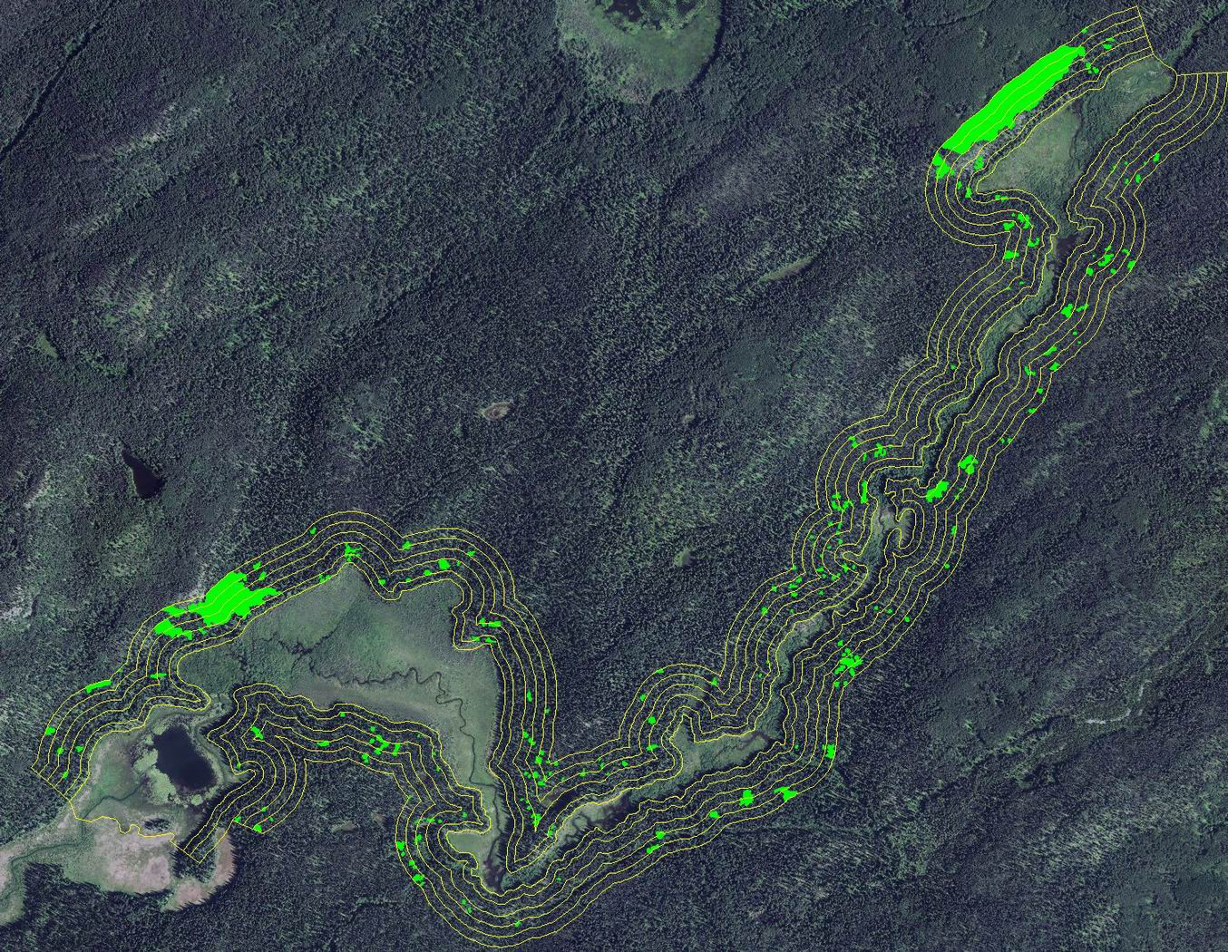

Slide 60
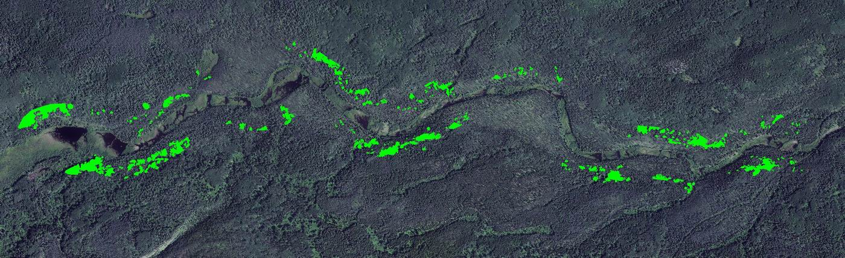
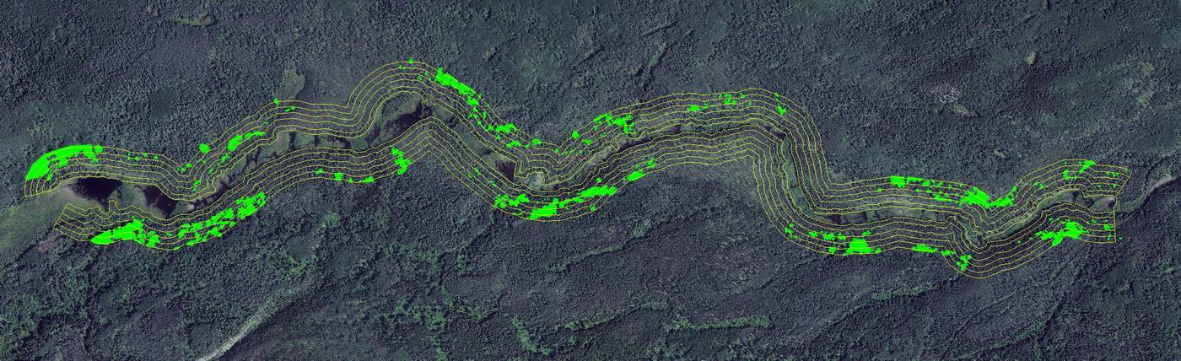

Slide 61
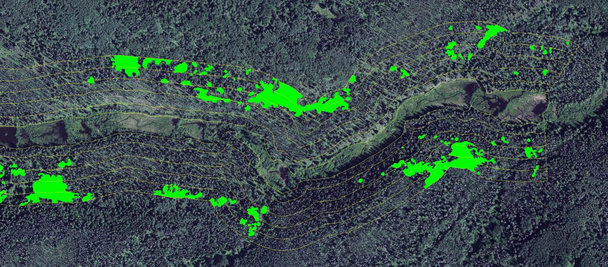

Slide 62
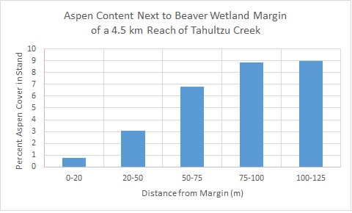
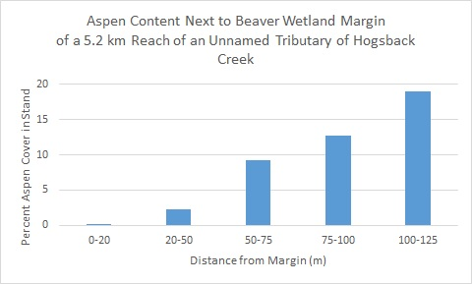

Slide 63
Recovery from Aspen Depletion
Lessons from the Kenney Dam Fire

Slide 64
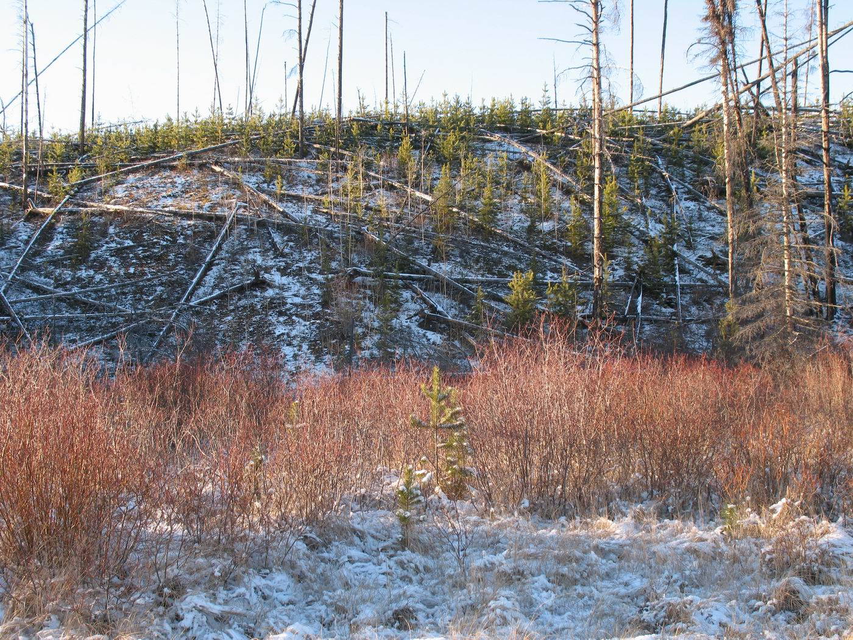

Slide 65


Slide 66


Slide 67


Slide 68


Slide 69


Slide 71
Species composition and condition of the uplands adjacent to streams that support beavers strongly affects how they in turn influence the wetland ecosystems.

Slide 72
Large landscape level disturbances in the form of fires rejuvenate the vegetation that is necessary for their survival.

Slide 73
Current Timber Harvesting Practices

Slide 74


Common to retain large, mature aspen wherever it is safe or operationally expedient to leave them standing.

Slide 75
S2, S3, W1, W5 Reserve Zones
Typically another 25% added for windfirmness
Up to 35 m systematically retained without
consideration of the actual riparian dynamics.

Slide 76
Consistent in short term with FPPR Section 8,
Objectives set by government for water, fish, wildlife and biodiversity within riparian areas

Slide 77
The objective set by government for water, fish, wildlife and biodiversity within riparian areas is, without unduly reducing the supply of timber from British Columbia's forests, to conserve, at the landscape level, the water quality, fish habitat, wildlife habitat and biodiversity associated with those riparian areas.

Slide 78
But is it appropriate in the longer term?
Alternate Practices to Consider…

Slide 79
Terrain already limits what we can do in many areas.
Notes:
Therefore, the retention of riparian zone vertical structure immediately following harvest is assured for at least some portion of these areas.

Slide 80
Terrain already limits what we can do in many areas.
Elsewhere, maybe ask these questions…
Notes:
Therefore, the retention of riparian zone vertical structure immediately following harvest is assured for at least some portion of these areas.

Slide 81
Is the harvest area adjacent to a stream with historic beaver activity?

Slide 82

If so, what does reconnaissance of the zone where beavers typically harvest aspen indicate about the potential for aspen suckering?

Slide 83



Are there old beaver-felled aspen stumps in the proposed harvest area, or closer than 20 m to the pond margin?

Slide 84

Is there a clear line beyond which mature aspen are present, but where no difference in site series or previous stand initiation events explains the absence of aspen closer to the stream?

Slide 85

Are there stands adjacent to the pond margin that may be fire remnants, with a low aspen potential, which are wider than the standard retention width, and which could be reserved in lieu of higher aspen potential sites?

Slide 86

Could a reserved area be control burned shortly after harvest, with the intent of also blackening soils in the harvest area within 100 m of the margin, prior to reforestation?

Slide 87

What is the likelihood that suckers will be heavily browsed by moose and unable to attain a size that beaver will use? Can scale of disturbance be set to reduce this possibility?

Slide 88
The answers to these questions should lead to harvesting layout and a site plan that considers burning of reserved stands and portions of cut block, discusses brushing restrictions, and thereby explicitly favors the development of aspen for the benefit of the adjacent aquatic system.

Slide 89


Slide 90

Canada will scrap the nickel within 5 years, Desjardins predicts

Slide 91

"eventually, the evolution of buying power could still justify changing to a $5 coin."

Slide 92


Slide 93
Notes:
Time is short – 20 minutes

